Slide 1
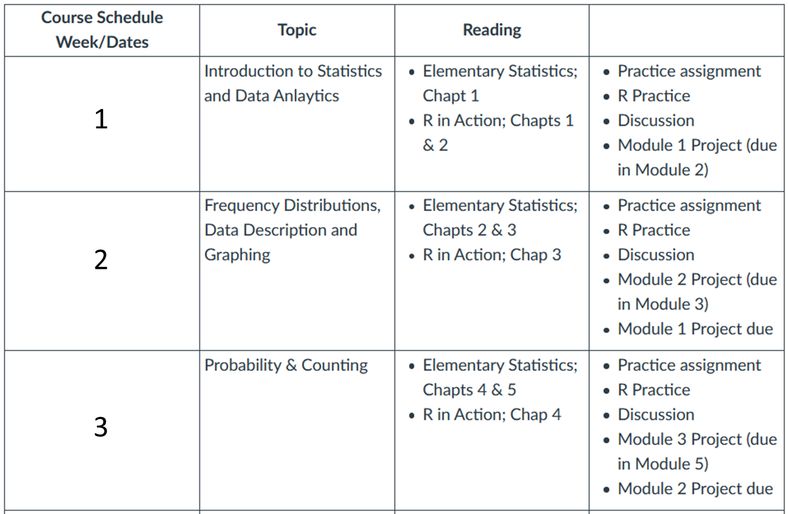
AYL6000 Introduction to Data Analytics

Slide 2
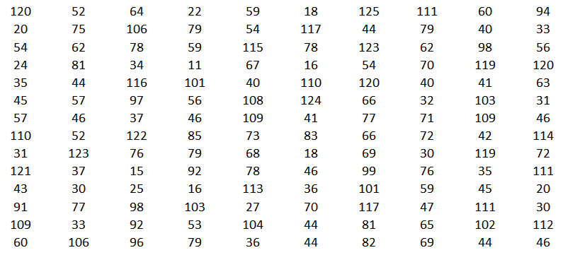
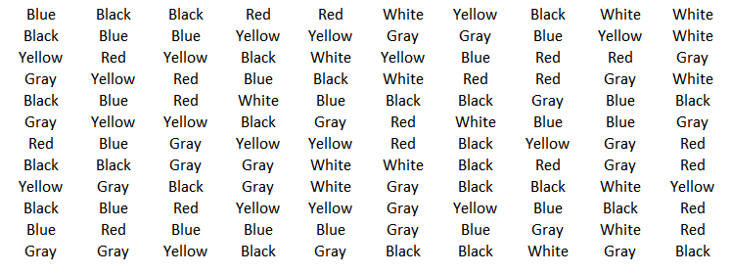
Numerical data
Categorical data

Slide 3
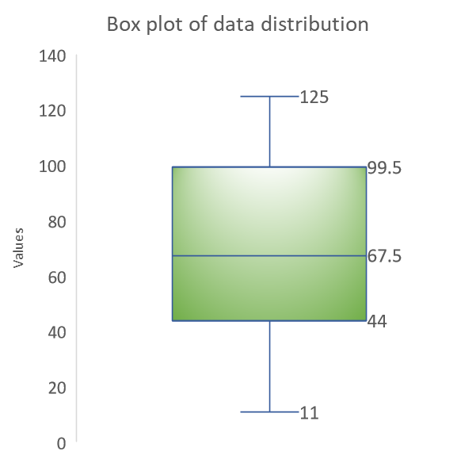

Slide 4
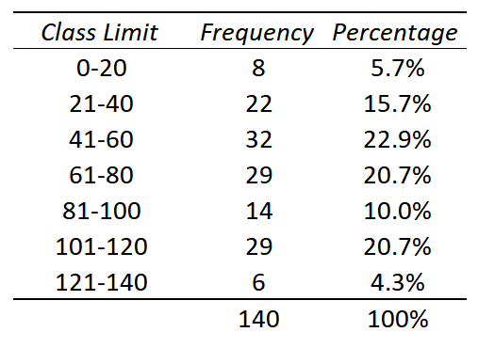
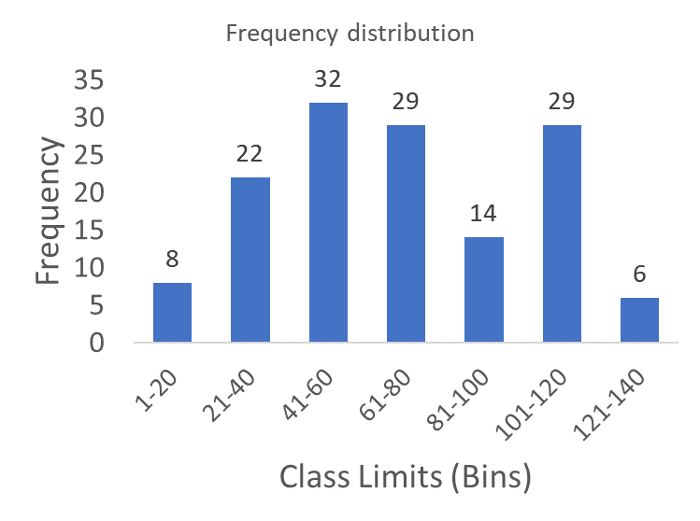

Slide 5
Continuous numerical data can be presented as categorical only if the data is organized in classes (bins). IN this case, each class is considered a category. In the example below, the data has been grouped in 7 categories

Slide 6
Rules to create classes from continuous numerical data:
There is flexibility in the number of classes, however, a general rules is to use between 5 and 20
It is preferable but not necessary that the class width be an odd number.
The classes must be mutually exclusive.
The classes must be continuous.
The classes must be exhaustive.
The classes must be equal in width.

Slide 7
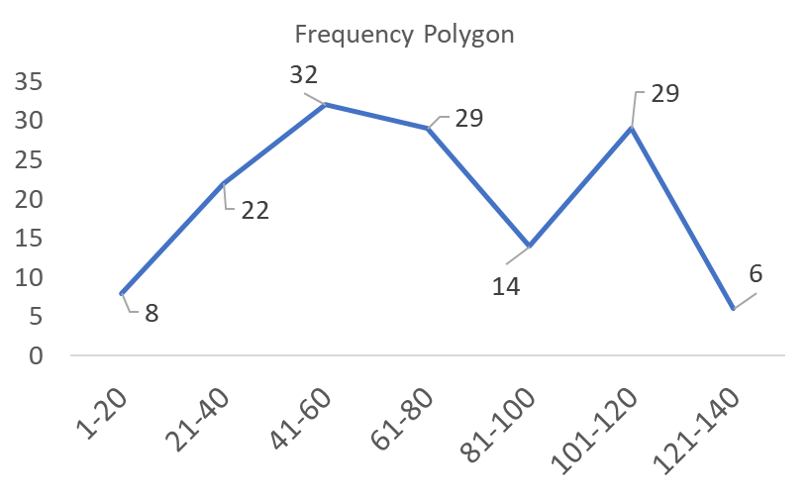
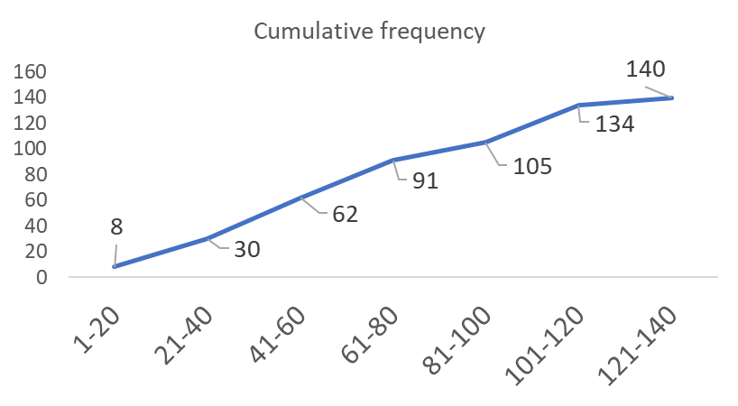
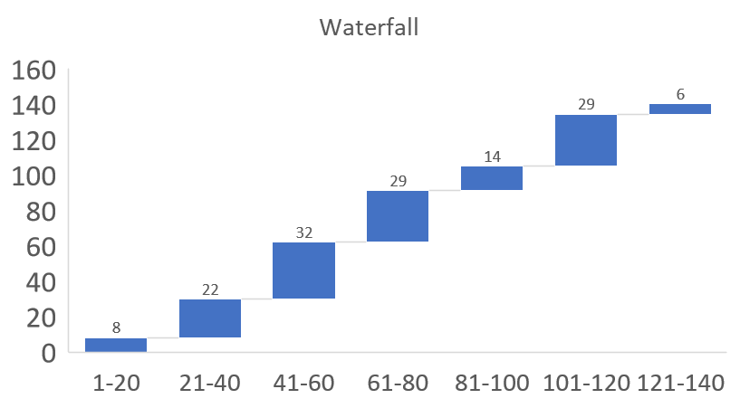
Other graphs to present this data

Slide 8
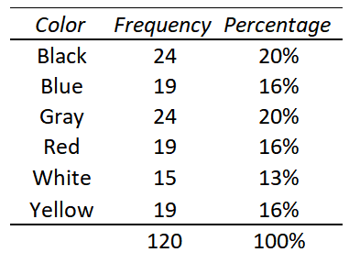
Categorical data

Slide 9
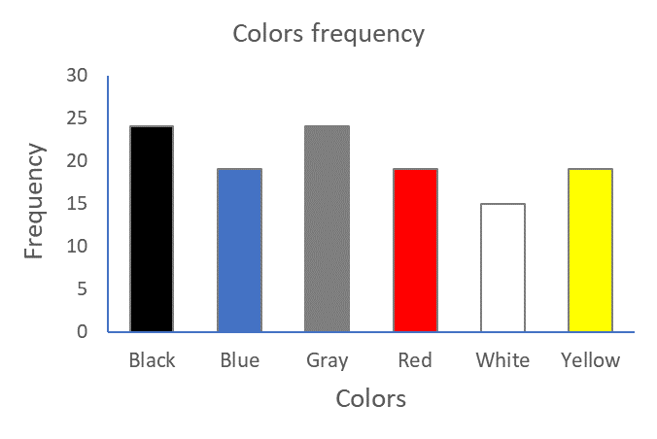
Categorical data

Slide 10
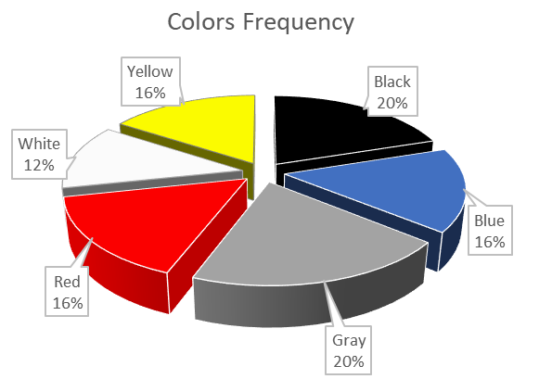
Categorical data

Slide 11
Before we see other graphs, let’s talk about your homework.
Last week discussion:
Select one product of your choice (e.g., a computer, video camera, watch, jacket, purse, car, etc.).
Search on the Internet for at least 10 different vendors (you can find several vendors on eBay, Amazon, etc.).
Collect the product price per vendor and prepare a table in Excel, include the names of the vendors, website, price of the product and shipping cost (if applicable).
Include descriptive statistics of your data set: mean, SD, median, maximum, minimum, range.
IMPORTANT: Insert your table as a JPG image.
Make sure your table has a professional look.
Finally, answer the following questions:
1. Did you find any challenge on your data collection procedure?
2. Was your data collection random? Explain how did you select the 10 vendors.
3. Based on the data collected and statistical analysis, what can you tell us about the distribution in prices? Apply critical thinking.

Slide 12
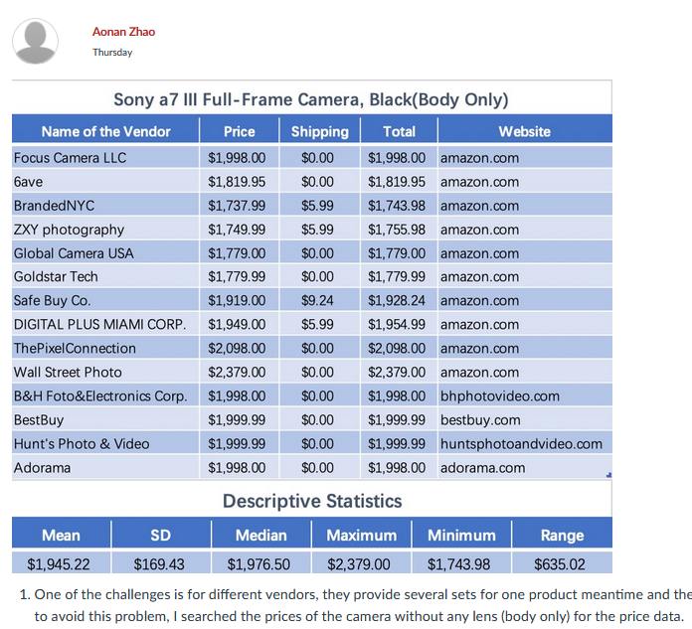
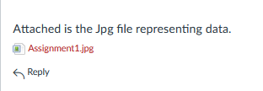

As much as it is possible, please try that your figures appear directly into the Discussion board view, and not as an attachment.
Do not add your primary response or replies as doc documents. The information must be entered directly into the Discussion board view.

Slide 13
We will create groups of two students: we will use the Zoom conference break rooms for this activity, including students in the classroom.
If you are presenting, share your table and explain your data collection method, what conclusion you made from your data, and any challenges you encounter.
If you are listening to your classmate, provide meaningful observations and advise on how to improve data presentation.
Each student takes maximum 5 minutes to present the data (including time to talk about your data and to receive feedback).

Slide 14
Bar graphs
Also referred as Bar Charts
Best used to present categorical data
Y-axis: Counts
X-axis: Categorical values

Slide 15
Bar graphs
Y-axis: Categorical values
X-axis: Counts

Slide 16

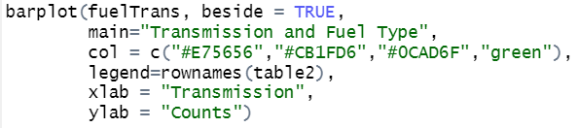
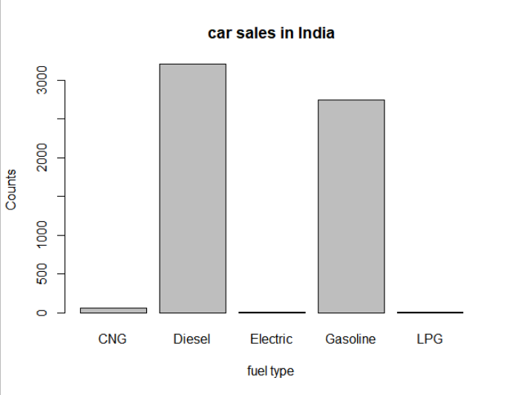
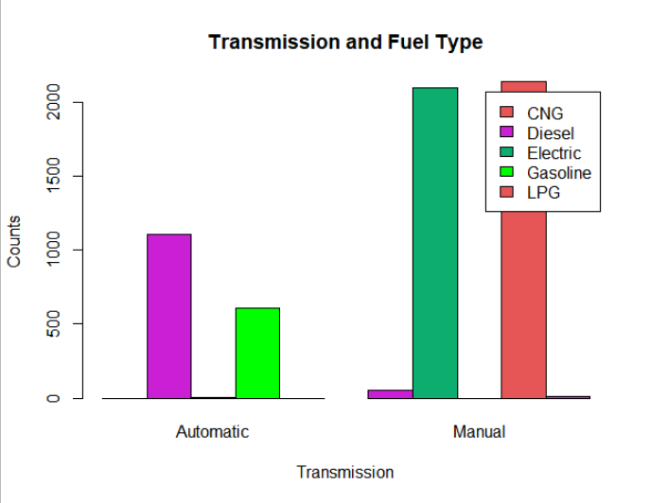
car_sale_india
fuel=table(cars$FuelType)
barplot(fuel, main="car sales in
India",xlab="fuel type",ylab = "Counts")

Slide 17
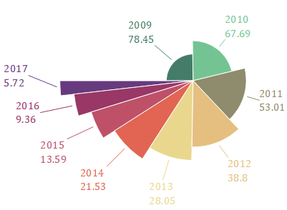
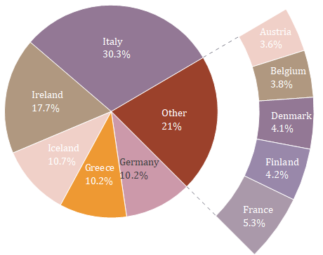
Pie Charts
A pie graph is a circle that is divided into sections or wedges according to the
percentage of frequencies in each category of the distribution.
Always be sure: Labels are clear. Values are indicated. Categories are easy to differentiate.

Slide 18
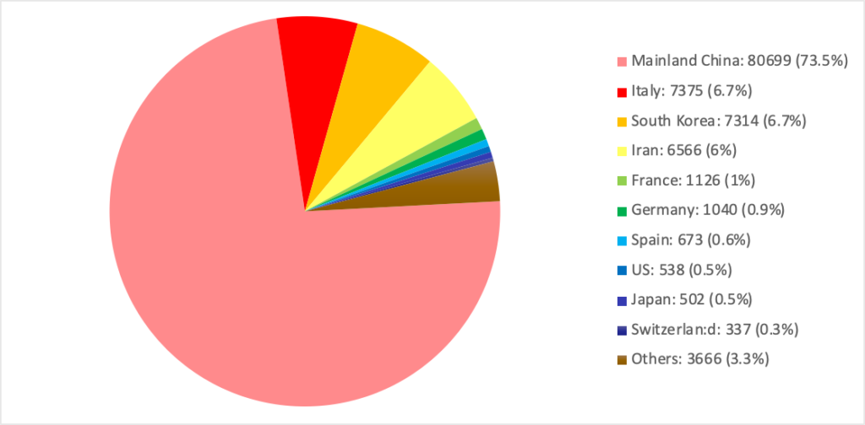
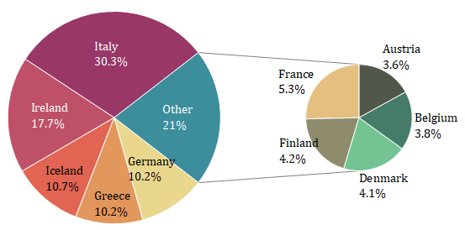
Pie Charts
There is a limit to the information you can present before it turns a pie chart into a complicated and difficult to follow graph
A strategy you can use

Slide 19
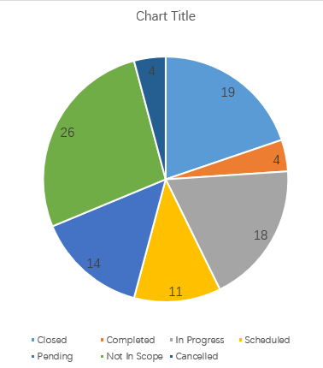
Pie Charts

Slide 20
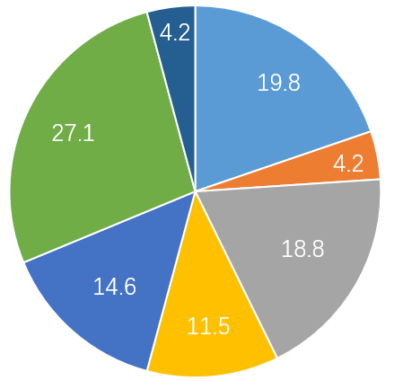
Pie Charts

Slide 21
Pie Charts
Cancelled
Closed
Not in scope
Completed
In progress
Pending
Scheduled

Slide 22
Pie Charts
Cancelled
Closed
Completed
Not in scope
In progress
Pending
Scheduled
You can use any style you prefer (develop your personal style) as long as your graphs are clear, easy to read and follow.

Slide 23
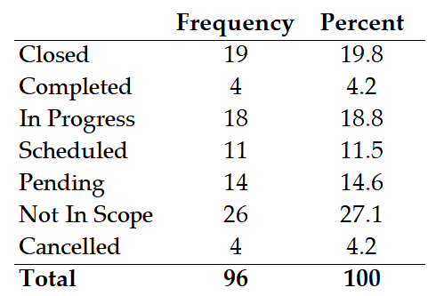
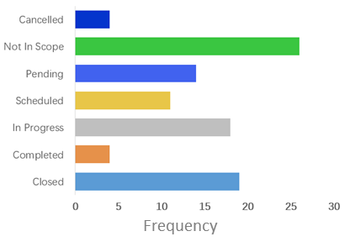
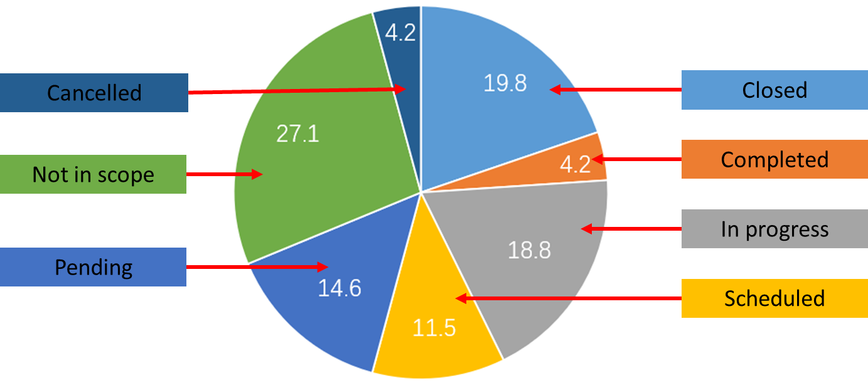
Pie Charts
Different ways to present the same data.

Slide 24
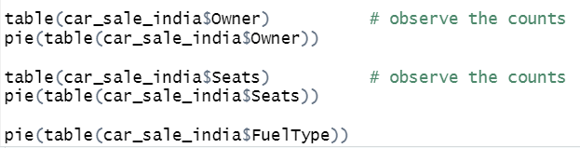


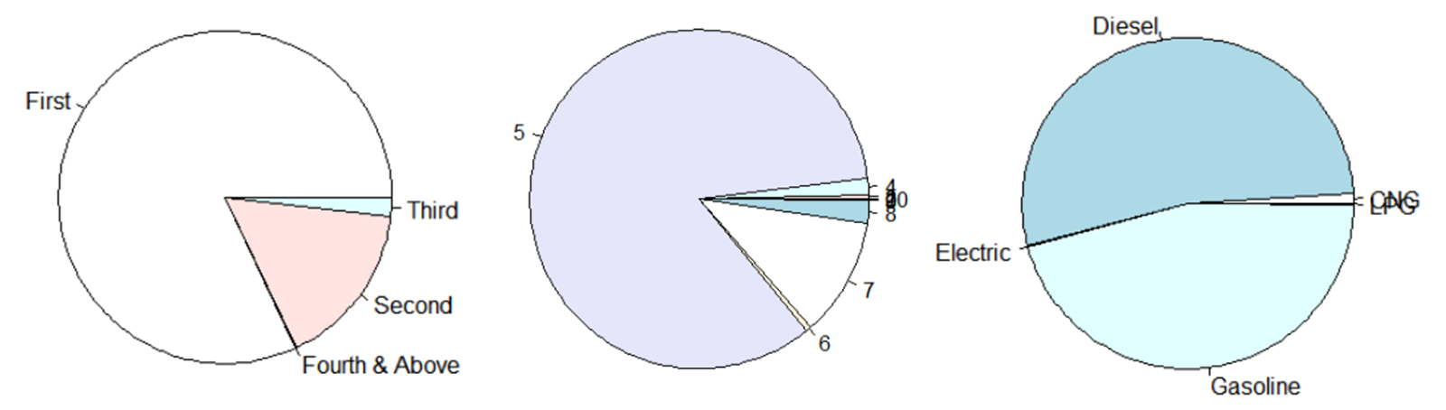

Slide 25
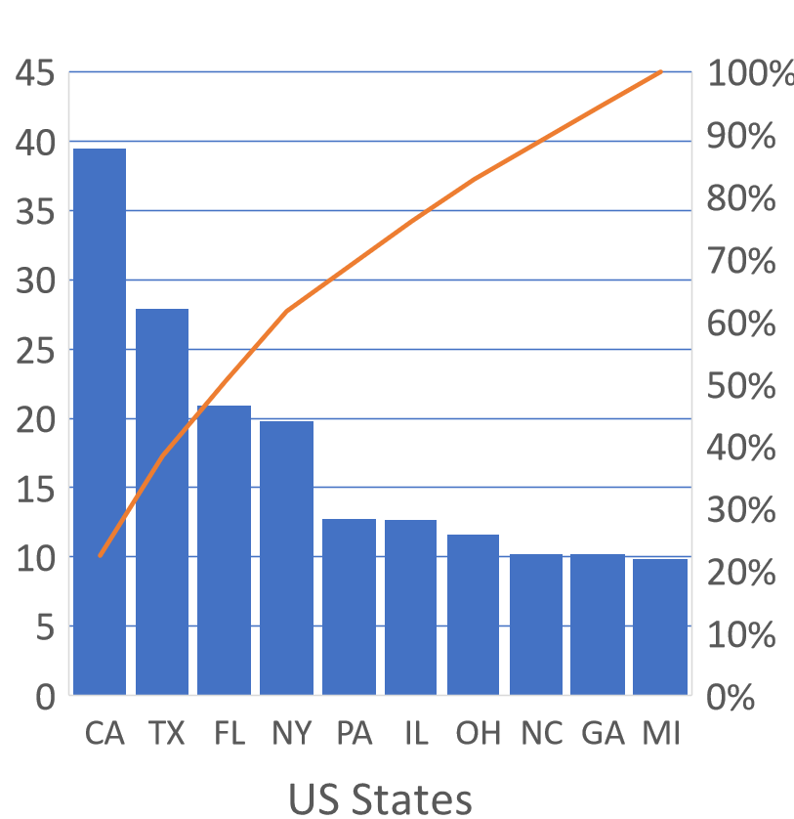
Pareto Chart
A Pareto chart is used to represent a frequency distribution for a categorical variable, and the frequencies are displayed by the heights of vertical bars, which are arranged in order from highest to lowest.
Population (in millions)
Cumulative relative frequency

Slide 26
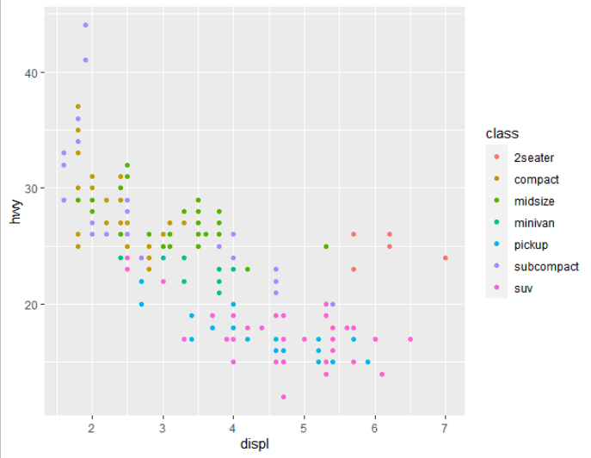
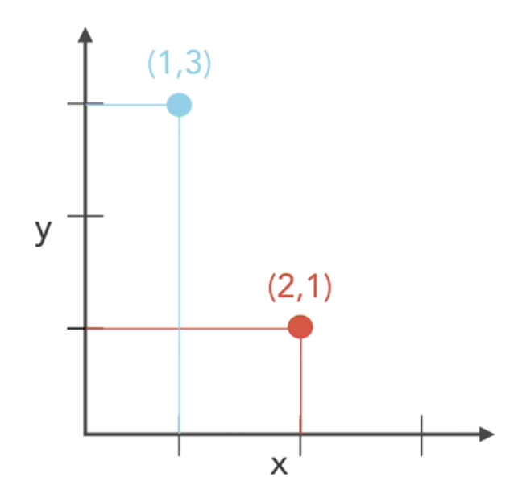
Scatter plots
Scatter plots follow the regular x to y coordinate grid coordinates. The first value always refer to the x axis. Used to observe the relationship between numerical variables

Slide 27
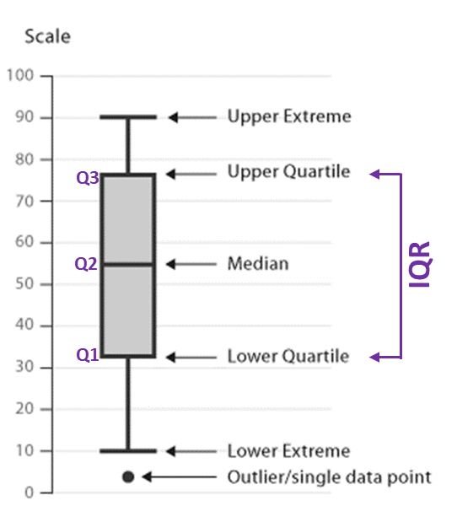
Box plots
A boxplot is a graph of a data set obtained by drawing a line from the minimum data value to Q1, drawing a horizontal line from Q3 to the maximum data value, and drawing a box whose vertical sides pass through Q1 and Q3 with a vertical line inside the box passing through the median or Q2.

Slide 28
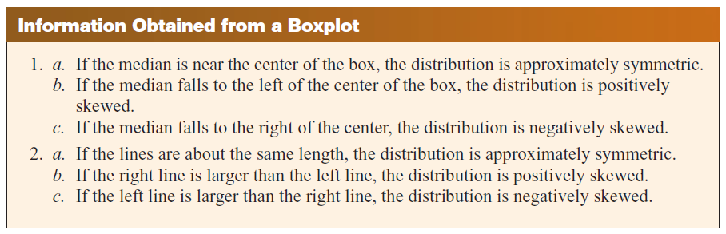
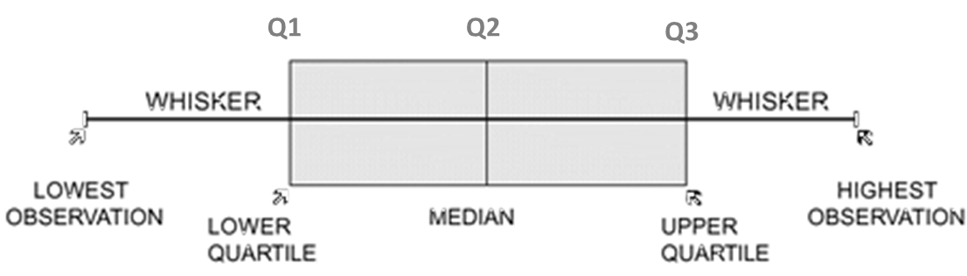
Box plots

Slide 29
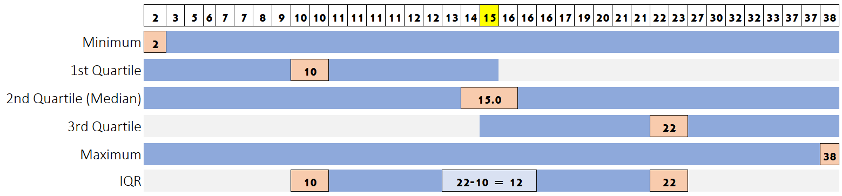
Box plots

Slide 30
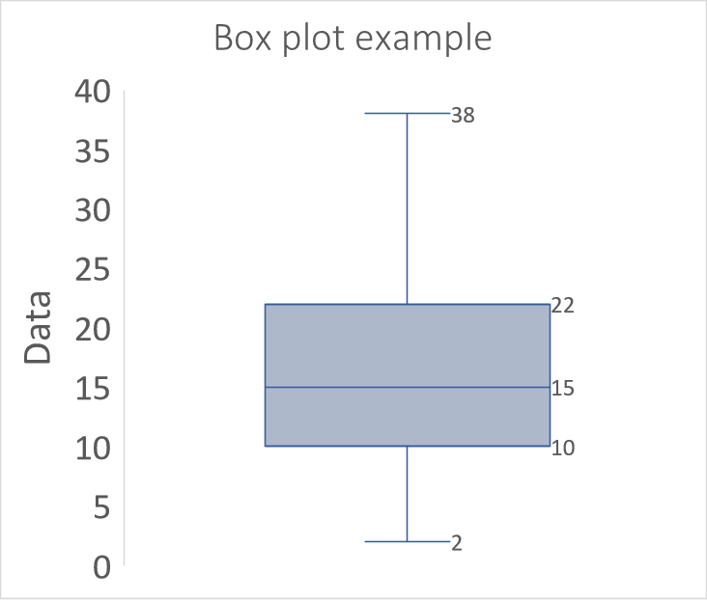

Slide 31
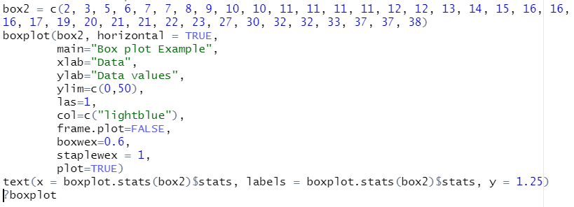
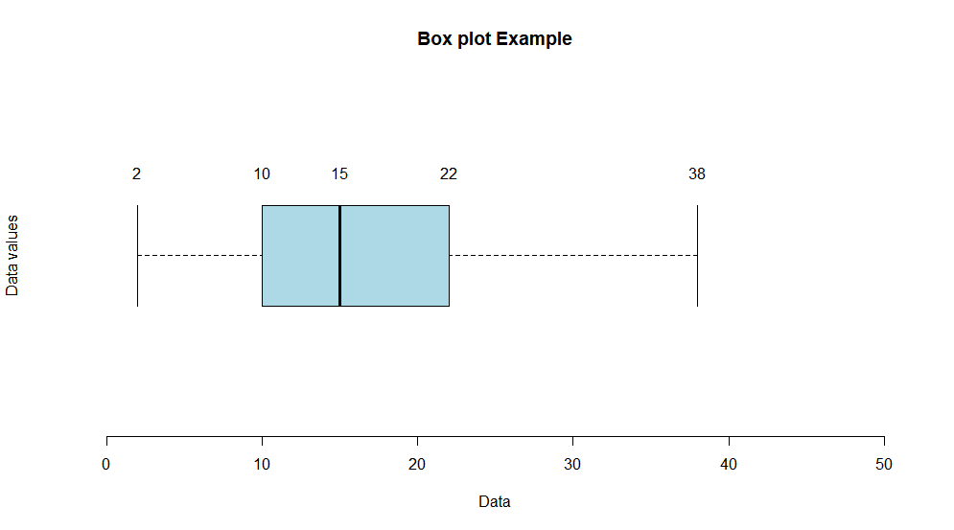

Slide 32

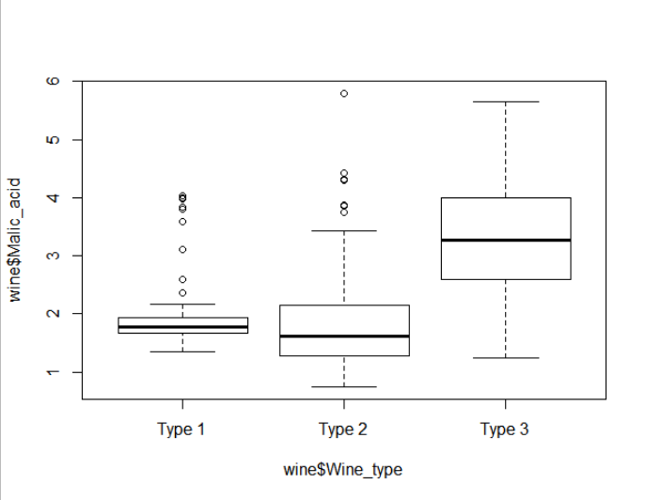
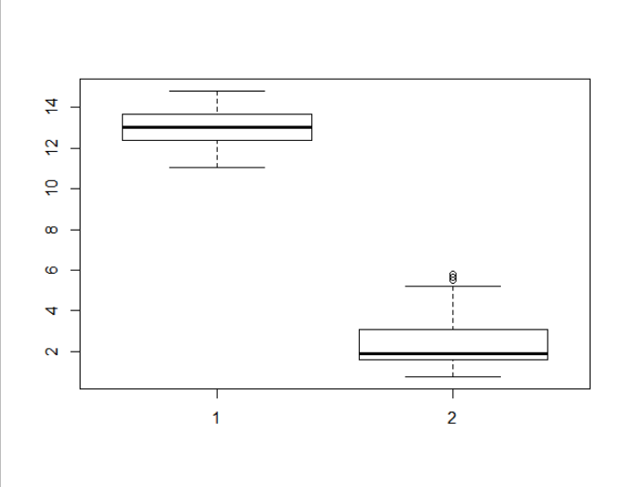

Slide 33
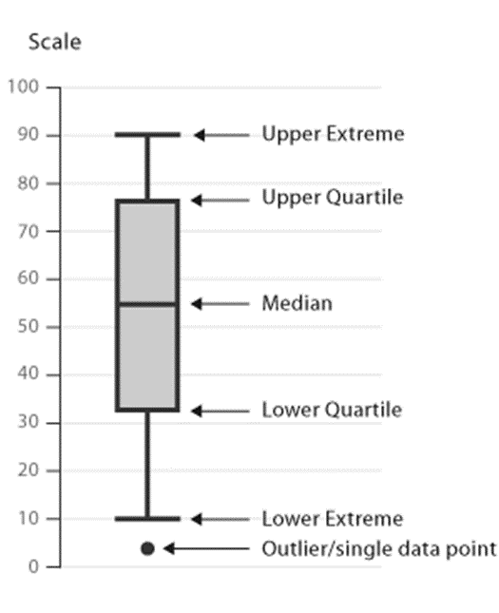
Solve the following problem, draw the box-and-whisker plots in a piece of paper.
Working by hand (not computer), create a box-and-whisker plot for the following data, and indicate if it contains outliers or not:
3, 42, 42, 46, 48, 49, 50, 50, 52, 53, 55, 56, 58, 75, 114
Q3
Remember:
Q2 indicates the median of the data set, or the average of the two middle numbers.
Q1 is the median of the lower set, between the lower point and Q2.
Q3 is the median of the upper set, between the highest point and Q2.
IQR or interquartile range, is the distance between Q1 and Q3.
Outliers are defined by any number that is lower than Q1 or higher than Q2 by 1.5 IQR.
Add the scale bar.
Indicate Q1, Q2, Q3, IQR, upper value, lower value, and any outliers.
Make the figure in a piece of paper with thick marker, to show to the camera.
Q2
IQR
Q1

Slide 34
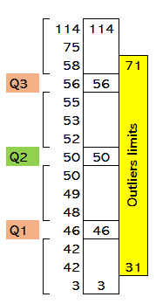
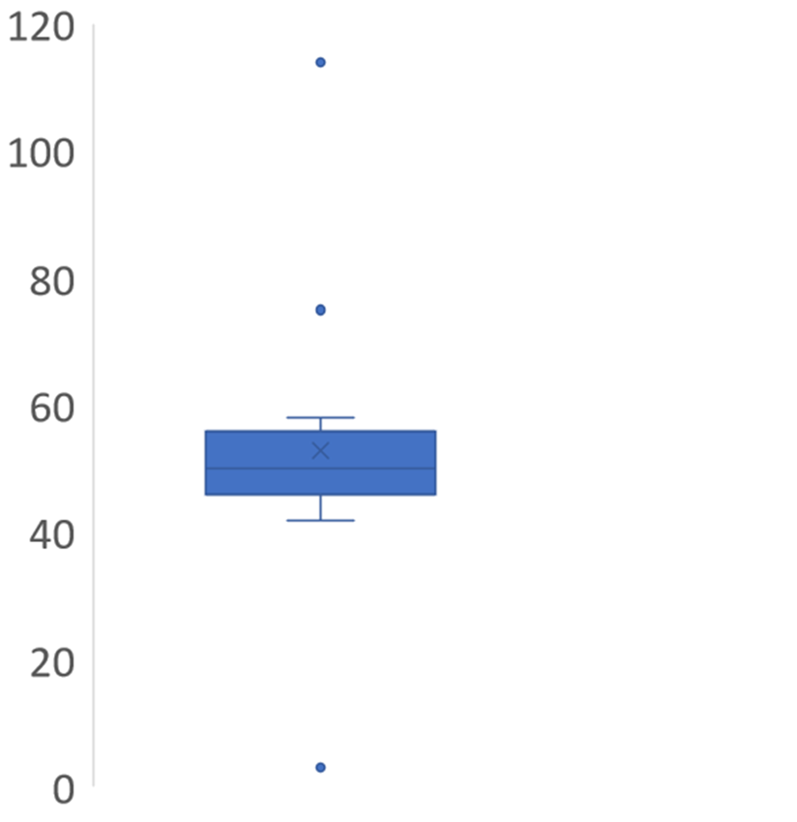
114
75
Upper value = 58
Q3 = 56
x
Q2 = 50
Q1 = 46
IQR = Q3 – Q1 = 56-46 = 10
IQR*1.5 = 10 x 1.5 = 15
Upper limit for outliers = Q3 + IQR*1.5 = 56 + 15 = 71
Lower limit for outliers = Q1 + IQR*1.5 = 46 – 15 = 31
Any value above 71 or below 31 are considered outliers.
In this case 3, 75 and 114 are outliers
Lower value = 42
3
In box plots, sometimes the mean is shown using an x. In this case, mean = 53

